Slide 1
Renewable Energy Four Ways in Urbana
Scott R. Tess
Sustainability & Resilience Officer
City of Urbana, IL
srtess@urbanaillinois.us
217-384-3281
Notes:
Energy and climate improvements of some sort are on most communities’ agendas.
But what to do and how to get started.
My goals is to move at least some of you from aspiration to implementation

Slide 2
1.
Notes:
Buy RECs
RECs are the renewable attributes of renewable energy production, reduced to a commodified, tradable certificate
Number one source of GHG reduction
How can you do this? Just ask your consultant for REC pricing.

Slide 3
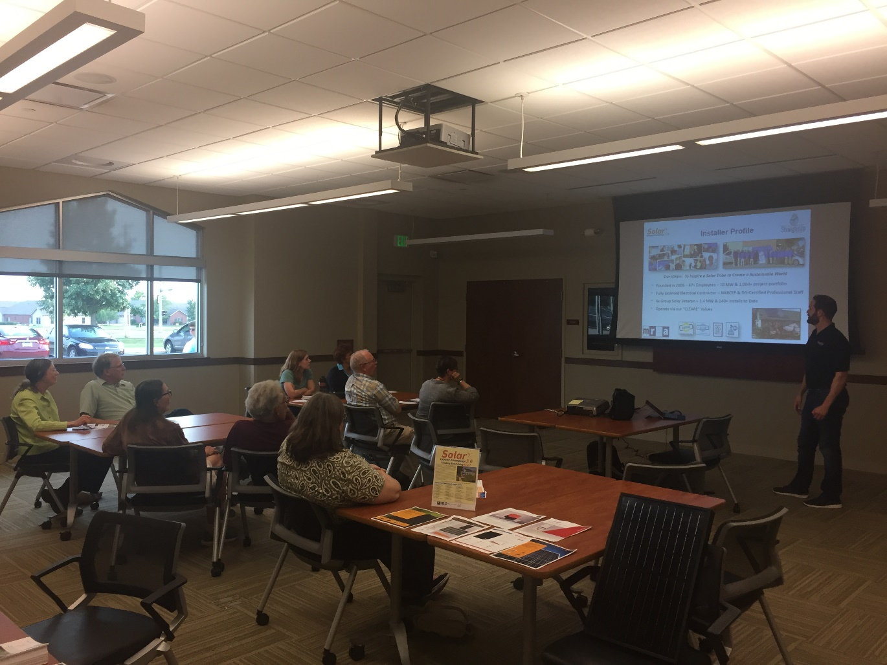
Bulk Solar Purchase Program or Group Buy
2.
NREL / MREA / Urbana model
Competitive Contractor Selection
Bulk & declining block pricing
Community-Led Outreach
Limited-time Offering
3+ megawatts, 3 counties, in 8 years
Notes:
We make solar faster, easier, and cheaper.
We combine bulk and declining block pricing with a series of educational events called Solar Power hours to move home and business owners from the idea of a solar array to an actual, in their hands installation proposal.
People spend years thinking should I, shouldn’t I on getting a solar installation. But once they have the specs and price in their hands, they spend only minutes or days.

Slide 4
Low Income Community Solar
3.
Notes:
Urbana, like so many, has a closed landfill.
Great location for medium scale solar array.
CS is, LICS is

Slide 5
Low Income Community Solar
3.
https://ilsfa.nexamp.com/ameren
5.3 mw of capacity, electricity for 500 to 740 households

Slide 6
Under Construction Here, Now Completed
3.

Slide 7
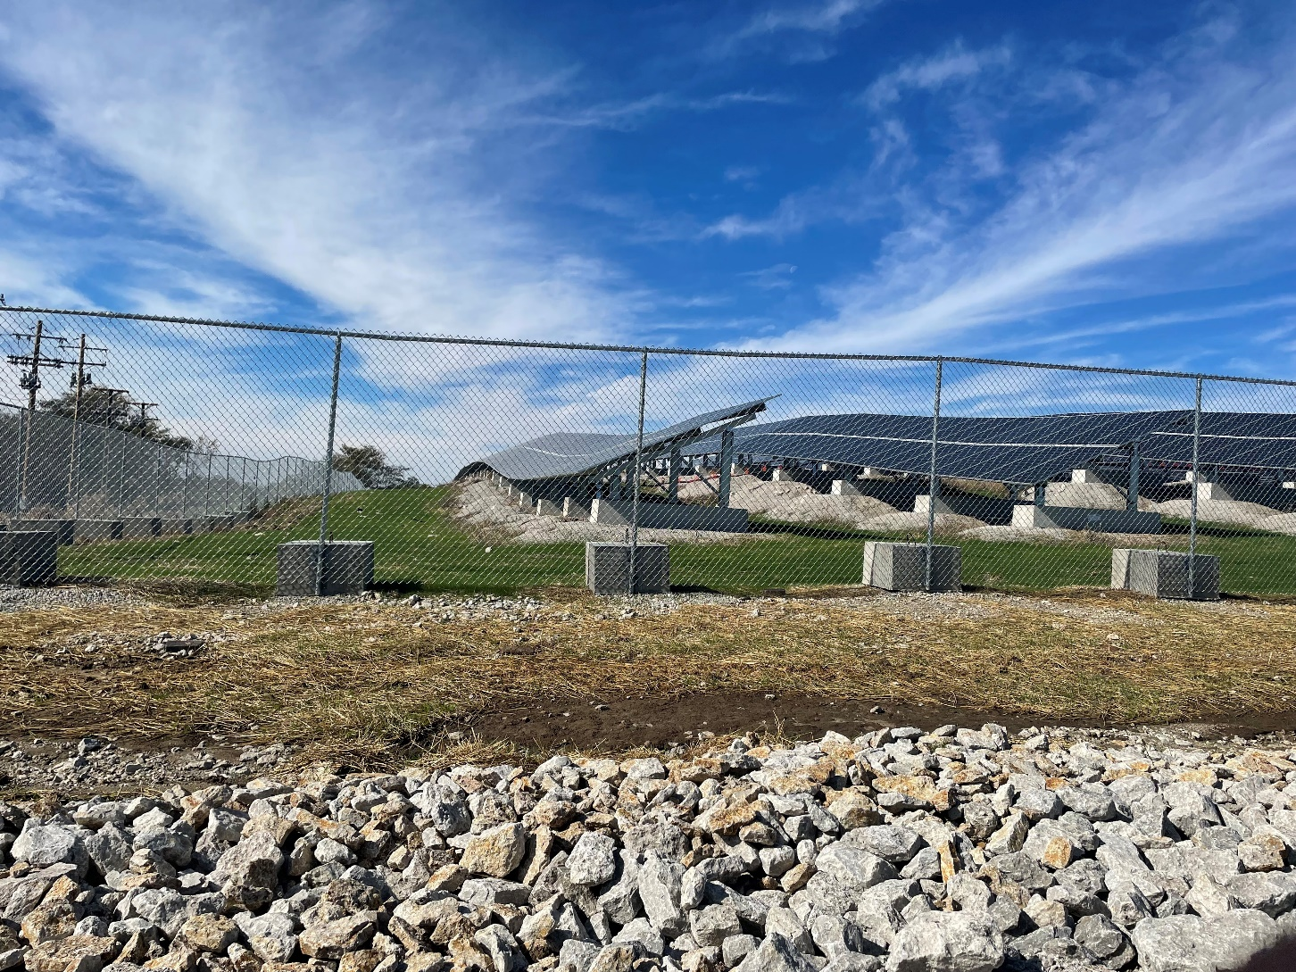
Low Income Community Solar
3.
Notes:
Things I knew, ballast racking
Things I didn’t know, ballast fence poles

Slide 8
Potential Landfill Solar 2.0
3.
Existing Solar

Slide 9
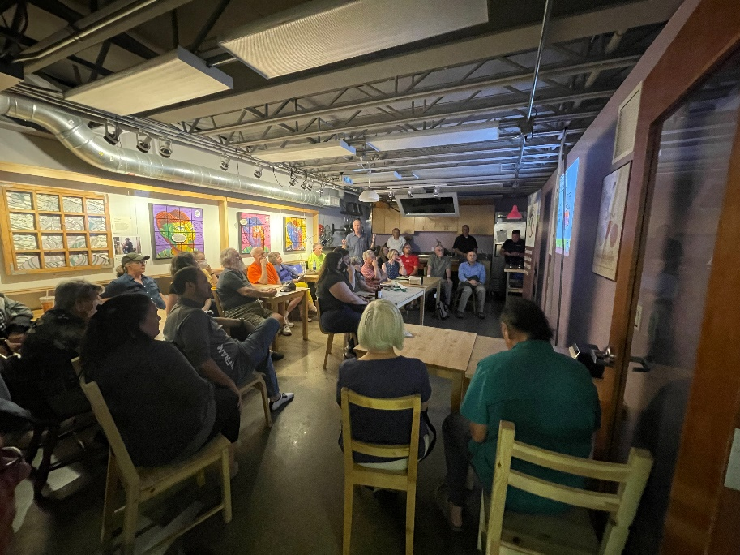
Bulk Geothermal Purchase Program or Group Buy
4.
Same model as Bulk Solar
203 tons of capacity, 3 counties, in 3 years
Now receives 30% tax credit / elective pay
Notes:
Same model as solar
Homes are 3-6 tons
Now get same tax credit
Geo is
Replaces fossil fuel methane gas and does so cheaper

Slide 10
Bulk Geothermal Purchase Program or Group Buy
4.
Driving down drilling cost is crucial
Smaller rigs that can get in back yards and basements is crucial
Notes:
In town res lots were little trod territory for most drillers

Slide 11
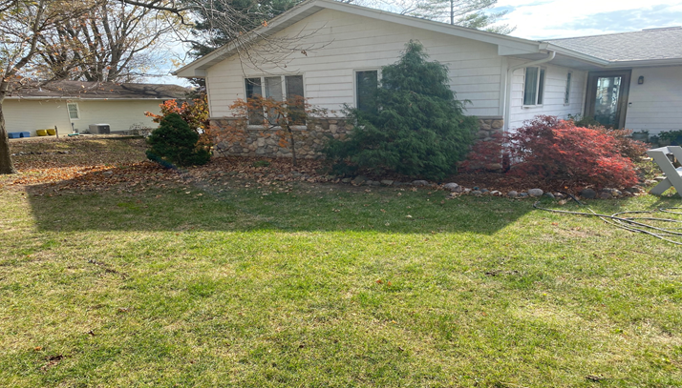
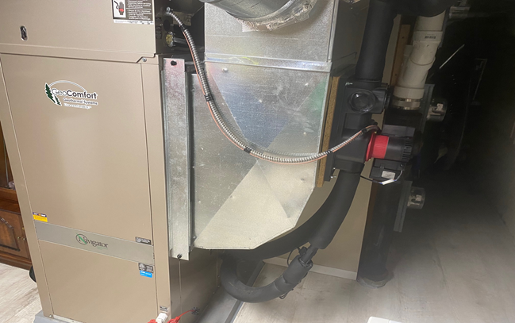
Bulk Geothermal Purchase Program or Group Buy
4.
Social norming decades behind solar
No serendipitous marketing

Slide 12
Bulk Geothermal Purchase Program or Group Buy
4.
Compelling drawbacks of burning fossil fuels inside our houses.
Rocky Mountain Insitute https://rmi.org/insight/gas-stoves-pollution-health/

Slide 13
Bulk Geothermal Purchase Program or Group Buy
4.
Compelling drawbacks to methane natural gas infrastructure

Slide 14
Bulk Geothermal Purchase Program or Group Buy
4.
Notes:
61% of U.S. households used natural gas for at least one energy end use

Slide 15
Thanks
Scott R. Tess
Sustainability & Resilience Officer
City of Urbana, IL
srtess@urbanaillinois.us
217-384-3281
Notes:
A final word about getting started

