Slide 1
State of Illinois Community Development Block Grant (CDBG) Public Infrastructure Program

Slide 2
Community Development Block Grant (CDBG)
U.S. Housing and Community Development Act of 1974
Amended in 1981 to allow states to directly administer the CDBG program for small cities.
Larger Cities and Counties receive Direct Entitlements
Not eligible for funding through State

Slide 3
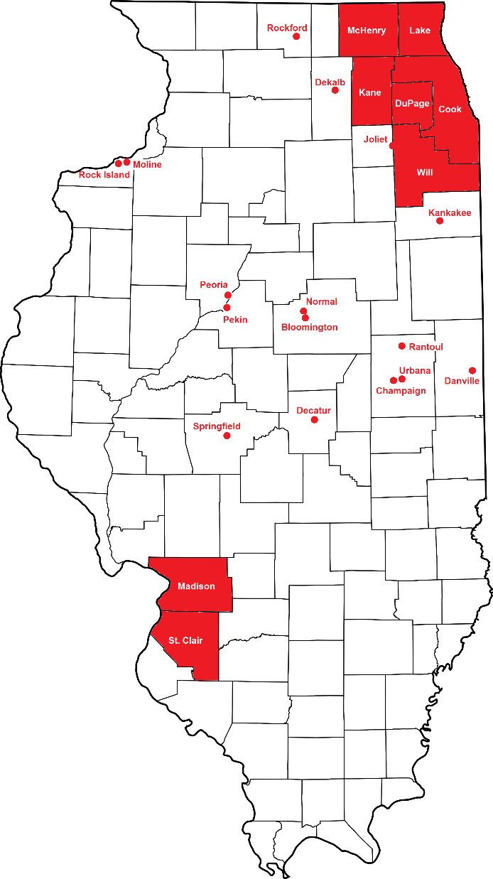
Ineligible Locations
Arlington Heights
Aurora
Berwyn
Bloomington
Champaign
Chicago
Cicero
Danville
Decatur
DeKalb
Des Plaines
Elgin
Evanston
Hoffman Estates
Joliet
Kankakee
Moline
Mount Prospect
Naperville
Normal
Oak Lawn
Oak Park
Palatine
Pekin
Peoria
Rantoul
Rockford
Rock Island
Schaumburg
Skokie
Springfield
Urbana
Waukegan

Slide 4
Funding Availability
Community Development Block Grant Program
Funded by the U.S. Department of Housing and Urban Development, by Program Year
$29.7 million in PY2022
$29.4 million in PY2023/24
$Lower in PY2025, per Congress
1.0 million in 2021
$29.7 million in 2022

Slide 5
CDBG Public Infrastructure Program
Grant Ceiling in PY2025 – Undetermined. Anticipate $650,000 - $1 million, incl. up to $35,000 for Activity Delivery (AD)
Annual Competitive Application
Application Workshop in August/September
Applications Due: mid-January
E-mail: ceo.ocd@illinois.gov to be added to monthly Hot Topics web sessions.

Slide 6
Eligible Activities
Flood & Drainage Improvements – acquisition, construction, rehabilitation of flood drainage facilities such as retention ponds or catch basins.
Water Improvements – installation, replacement, re-lining of water lines, water treatment plants
Sewer Improvements – installation, replacement, re-lining or separation of sanitary sewers and storm sewers, sewer treatment plants.

Slide 7
Eligibility Thresholds
Only units of local government (cities, villages, counties, townships) may apply/receive a CDBG grant.
May apply “on behalf of” rural water or sewer co-ops
Project must benefit at least 51% Low-to-Moderate Income persons

Slide 8
Eligibility Thresholds
Threat to Health & Safety – a serious threat is defined as a deficiency in the community facility or lacks the facility entirely, problems related to the deficiency have occurred such as serious illness, disease outbreak, or serious environmental pollution; and the problem is present, continual and chronic as opposed to occasional, sporadic or problematic.
Water and Sewer Rate minimum
Rate currently meets or exceeds 1 percent of the Median Household Income per 5,000 gallons.
Rate minimum for the type of project
N/A for storm sewer, sewer separation, drainage

Slide 9
Scoring Criteria (PY 2025)
Opportunity Zone = 3 points
DCEO Underserved Area = 2 points
Project Impact/Per Capita = up to 10 points
Additional Funding = up to 10 points
Threat to Health & Safety = up to 25 points
Project Readiness = up to 50 points

Slide 10
IEPA Permit (PY 2025 Onwards)
Projects requiring an IEPA Construction Permit must have Permit copy in application submitted in January, or will be deemed “Do Not Fund”;
Helps DCEO meet HUD and Congressional mandates to spend CDBG in a timely manner.

Slide 11
Other CDBG Programs
Annual Allocation:
Economic Development
Housing Rehabilitation
Disaster Response
CARES/CDBG-CV:
Urban Shelter (current NOFO)
Rural Shelter (April)
Healthy Houses (Later 2024)

Slide 12
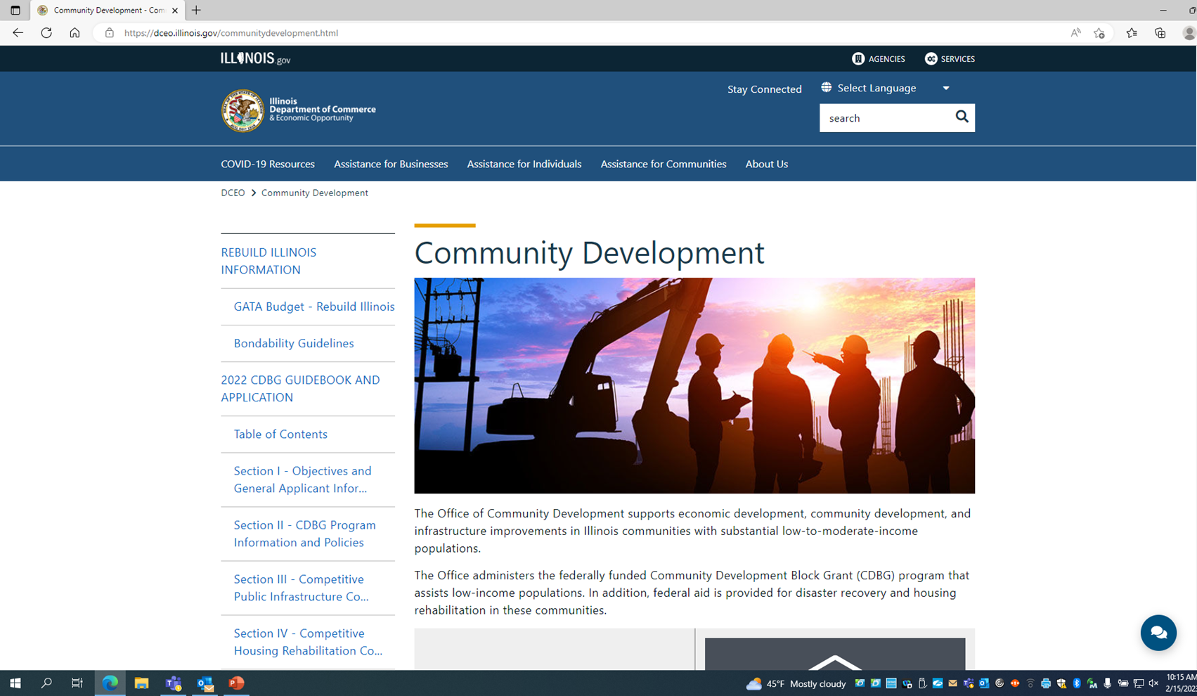
For More Information: dceo.Illinois.gov

Slide 13
Contact Info
Wendy Bell
Deputy Director
Office of Community Development
Department of Commerce & Economic Opportunity (DCEO)
Wendy.Bell@Illinois.gov
217/558-4200

Slide 14
Contact Info
Kirk Kumerow
Public Infrastructure Program Manager/ERO
Office of Community Development
Department of Commerce & Economic Opportunity (DCEO)
kirk.kumerow@Illinois.gov
217/558-4106

