Slide 1
Illinois EPA Public Water Infrastructure Program
April 23, 2024
Providing effective energy strategies for buildings and communities

Slide 2
Who We Are
We are an applied research program at University of Illinois.
Our goal: Reduce the energy footprint of Illinois and beyond.
We assist buildings and communities in achieving energy efficiency, saving money, and becoming more sustainable.

Slide 3
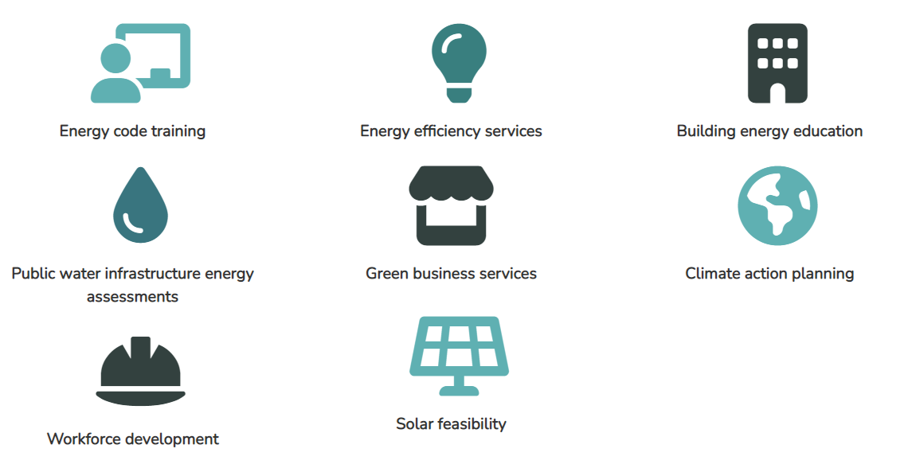
Mission: Decrease the energy footprint of Illinois and beyond.

Slide 4
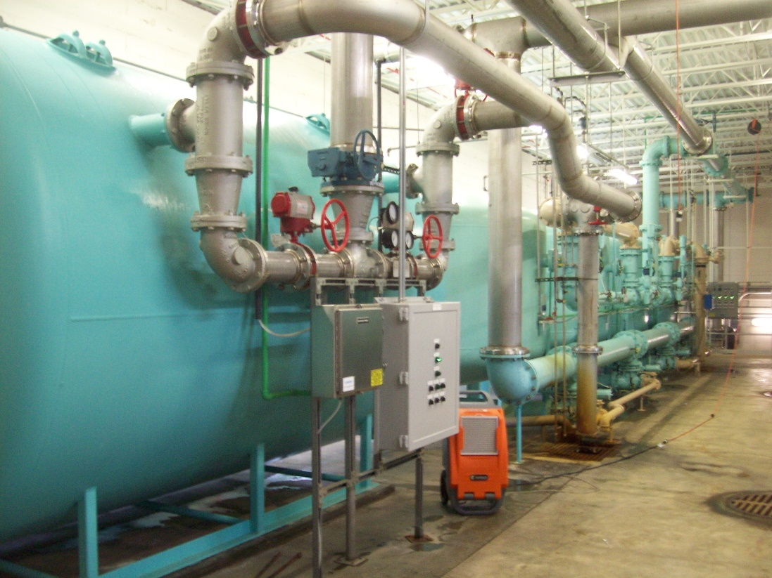
About the IEPA PWI Energy Efficiency Program
The Illinois EPA Public Water Infrastructure Energy Assessment Program helps municipalities reduce the cost of water and wastewater treatment.
NO-COST energy assessments and technical assistance
Limited number of slots remaining!
Comprehensive report listing:
Cost of upgrades
Estimated payback period
Any applicable incentives or funding opportunities
Operator continuing education events
Funding provided in whole or in part by the Illinois EPA Office of Energy. This program is in partnership with the U.S. Dept. of Energy Sustainable Wastewater Infrastructure of the Future (SWIFT) Accelerator for energy efficiency in wastewater treatment.

Slide 5
Why Complete an Energy Assessment?
Older Existing System or No Previous Assessments?
Identify missed opportunities
Plan for capital improvements
Uncover what is possible
3rd party support for personnel’s ideas
New or Recently Upgraded?
Always more to improve
Plan for future opportunities outside the scope of recent projects
New technologies and processes always in development
Identify opportunities for repairs or upgrades and associated funding!

Slide 6
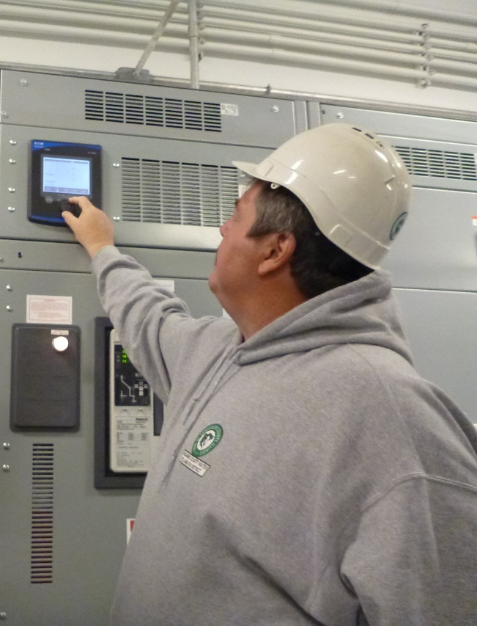
Apply for an Energy Assessment!
Step 1: Initial Application – Pre-Qualification
Apply at www.smartenergy.illinois.edu/water
Be located in Illinois and be publicly-owned
Allow SEDAC/ISTC to visit site – remote visit is an option!
Be willing to share facility information
Share final assessment report with Illinois EPA Energy Office
Step 2: Data Collection
Facility information –Process flow diagram, types of processes, etc…
2 years of utility bills and MORs
We’re here to assist!
Step 3: Site Visit Scheduled

Slide 7
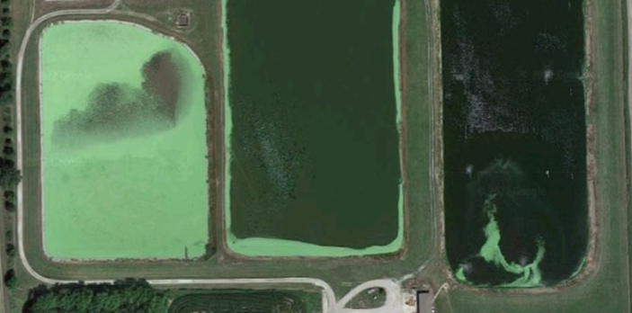
Case Examples
Village of Heyworth WTP
Properly sized pumps – 6% of total energy use, $200/month, 15% utility incentives

Slide 8
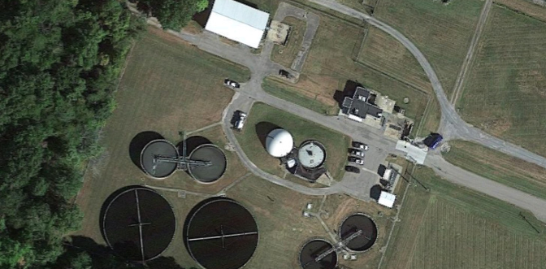
Case Examples
Village of Herrin WWTP
Despite energy increasing by 18%, electric consumption dropped significantly - $13,000 in savings

Slide 9
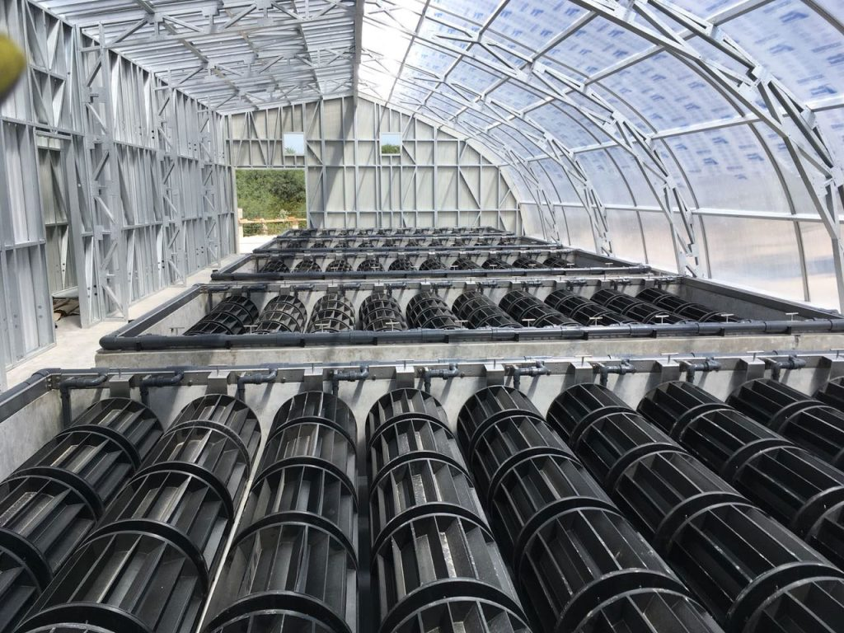
Upcoming Field Day
May 15, 2024
Field Day Announcement!
Tour of Algaewheel Process: Distributed treatment system for Bookwalter Woods MHP near Gardner, IL
Algal Treatment Processes Workshop: Location TBD
Applications at distributed and central WWTPs
Benefits for nutrient removal and energy consumption
Side-stream income opportunities

Slide 10
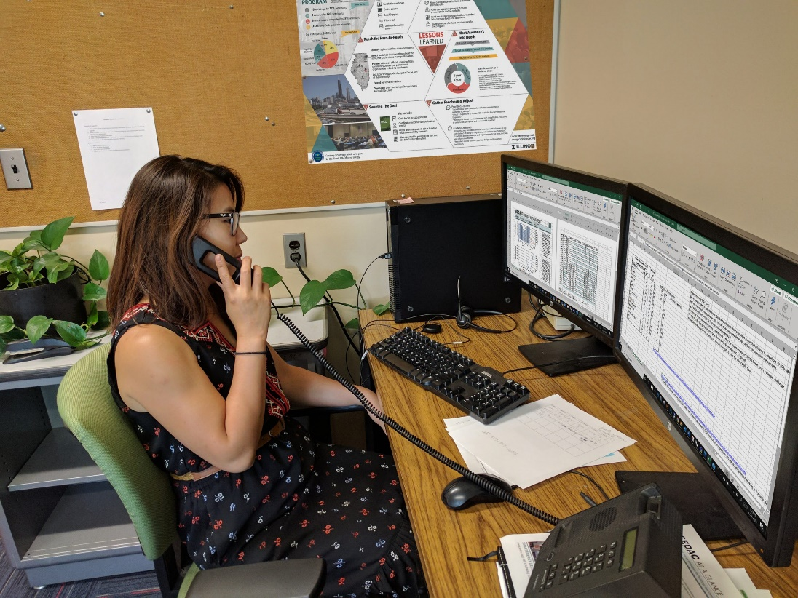
Other Programs for Municipalities
No-Cost Energy & Sustainability Assessments for the following industries (US EPA P2 Funded):
Metal Finishers
Auto Body & Repair Shops
Breweries
Energy Code Training & Technical Assistance
Environmental Justice Thriving Communities Technical Assistance Center
Energy Assessments & Quick Advice

Slide 11
Other Programs for Municipalities
No-Cost Energy & Sustainability Assessments for the following industries (US EPA P2 Funded):
Metal Finishers
Auto Body & Repair Shops
Breweries
Energy Code Training & Technical Assistance
Environmental Justice Thriving Communities Technical Assistance Center
Energy Assessments & Quick Advice

Slide 12
BRITE Program
Launched in 2022 due to Covid relief funding from the American Rescue Plan Act (ARPA).
Free on-site technical assessments for dry cleaners, auto body & auto repair shops, food & beverage manufacturers, and metal finishers located in suburban Cook County.
Recommendations cover energy, waste, toxics, and water reduction opportunities.
Each site can request up to $300,000 for the recommendations on the reports. The County will 100% cover the top pollution prevention project and cover up to 50% for any other recommendation excluding fossil fuel-based projects will only receive a maximum of 25% funding.
Notes:
Businesses receive assessment report detailing pollution reduction opportunities, costs of implementation, and business cost savings.
Qualified businesses interested in reducing pollution from daily operations can receive funding to enhance business operations.

Slide 13
Questions?
Cassie Carroll
SEDAC
ccarrol2@illinois.edu
217-300-6477
www.smartenergy.Illinois.edu/water

