Slide 1


Illinois Geothermal Coalition: Supporting the Electrification of Illinois Communities
Presented by Andrew Stumpf, Ph.D
Co-Founder, Illinois Geothermal Coalition
Principal Research Scientist
Illinois State Geological Survey, Prairie Research Institute

Slide 2
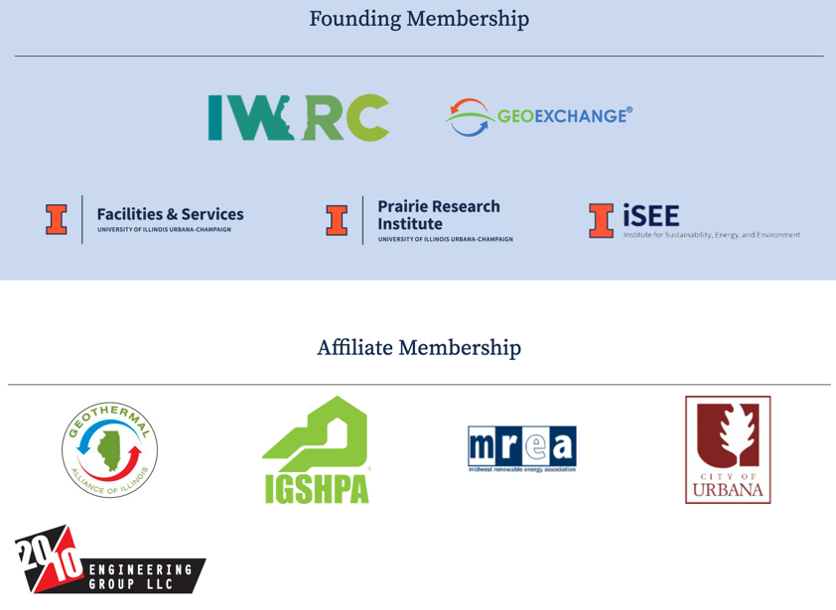

Illinois Geothermal Coalition
https://geothermal.illinois.edu

Slide 3
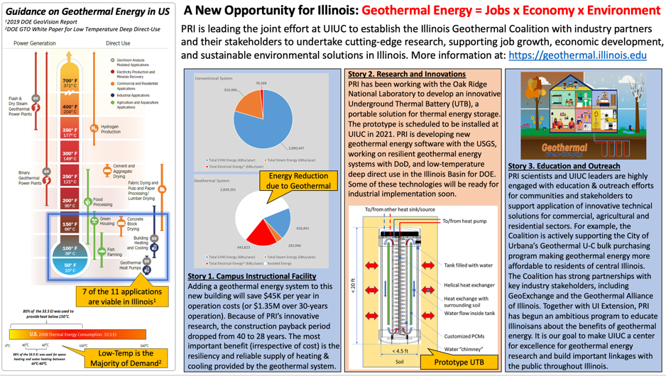

Slide 4
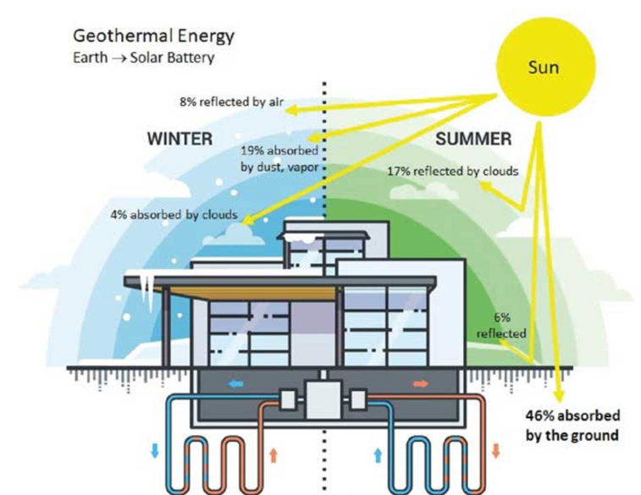
Notes:
The sun is what allows geo to work. The earth absorbs the suns heat.

Slide 5
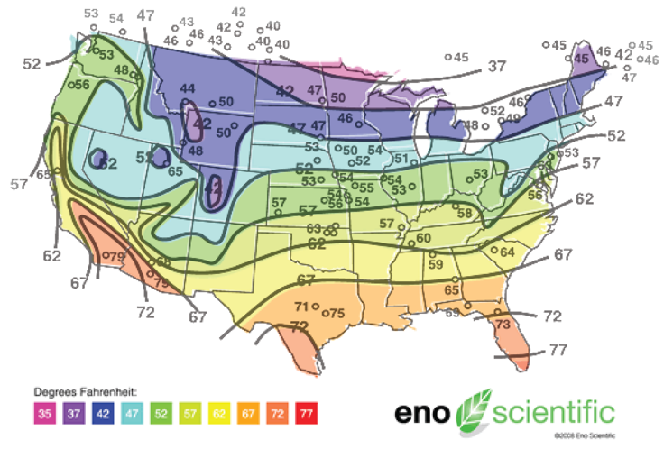
Depending on latitude, the groundwater temperature beneath the upper 20 feet (6 meters) of Earth's surface maintains a nearly constant temperature between 10 – 16 °C (50 – 60 °F). Geothermal exchange systems are designed to take advantage of these moderate temperatures in the ground to boost efficiency and reduce the operational costs of heating and cooling systems.
Notes:
By absorbing the suns heat…earth temperatures remain very stable.

Slide 6
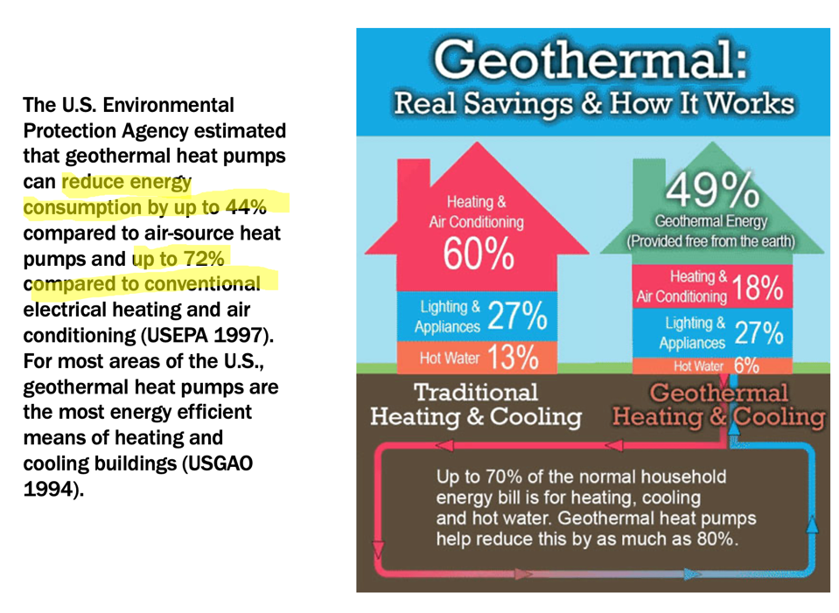

Slide 7
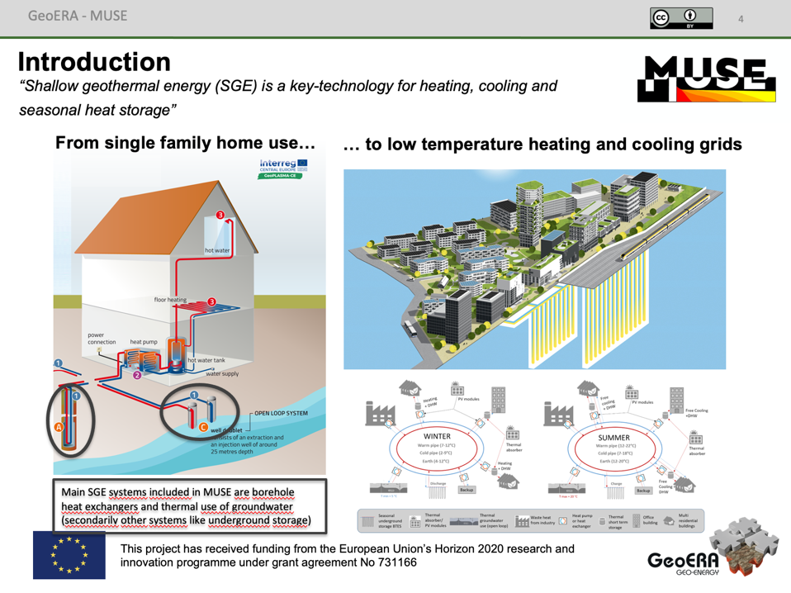

Slide 8
