Slide 1
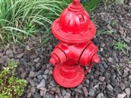
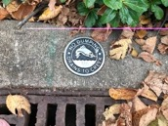
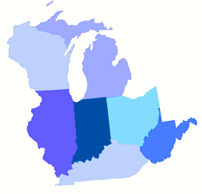
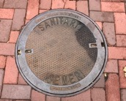

Regional Collaboration
James Meece, Sr. Rural Development Specialist
Brock Teichmiller, Sr. Rural Development Specialist
Presented by Great Lakes RCAP

Slide 2
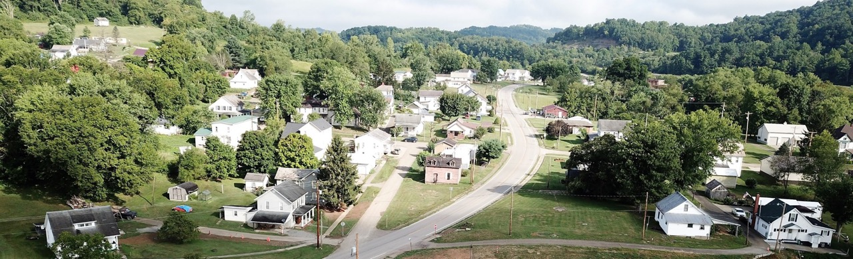

Goals
Our Mission
Improve surface water protection, environmental compliance, public health, economic readiness and quality of life in small communities and rural areas.
Help small and rural communities access funding for water and sewer projects.
Improve the technical, managerial and financial capabilities of water and sewer systems.
Promote shared services and regionalization projects to increase efficiency, reduce end-user costs, and ensure long-term sustainability.
Notes:
Erik

Slide 3


America’s Water Infrastructure Challenges
Estimated $2 trillion needed to fix our U.S. Water Infrastructure.
Roughly 1.1 million miles of water main in U.S.
  Avg. 240,000 miles of water main break annually
    2018 study revealed water main ruptures are up 27% over the past 6 yrs.
  Estimated 2 trillion gallons of already treated water lost each year.
    Estimated $10.2 billion lost each year from this water loss.
Cost of infrastructure and compliance per user continue to rise
What will happen when State & Federal subsidization continue to dry up?
Notes:
D All of the above

Slide 4
America’s Water Infrastructure Challenges
Worker shortage
  Currently there are 300,000 water utility workers in U.S.
    They are on avg. 46 yrs of age
    Retirements are plaguing water utilities nationwide
      Reports of staffing vacancies are up to 50% in some parts of the country
Volunteer shortages
Water service is financially a low margin high volume business.
Small systems have limited resources (technical, financial, and Managerial)
  Water systems are not ran like a business
Consumer expectations are evolving
Notes:
D All of the above

Slide 5
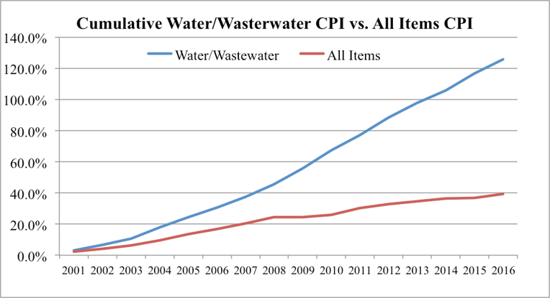
What’s Trending in the Water/Wastewater Sector
Historical chart of the Water and Wastewater Maintenance Consumer Price Index (CPI)
compared to the All Items CPI from the Bureau of Labor Statistics (the Water and Wastewater
Maintenance CPI is a subset of the All Items CPI).
Notes:
D All of the above

Slide 6
Economies of Scale
How does it work?
Notes:
D All of the above

Slide 7
U.S. Water Utilities
System Population​ | Very Small​ 500 or less​ | Small​ 501-3,300​ | Medium​ 3,301-10,000​ | Large​ 10,001-100,000​ | Very Large​ 100,000+​ | Total​
# Systems​ | 28,595​ | 13,727​ | 4,936​ | 3,851​ | 426​ | 51,535​
% of Total Systems​ | 55%​ | 27%​ | 10%​ | 7%​ | 0.8%​ | 100​
Served Population​ | 4,738,080​ | 19,688,745​ | 28,758,366​ | 109,769,304​ | 137,250,793​ | 300,205,288​
% of​ Total Population​ | 1.6%​ | 6.6%​ | 10%​ | 37%​ | 45.7%​ | 100​
Avg. People per System​ | 166​ | 1,434​ | 5,826​ | 28,504​ | 322,185​ | 5,825​
Source: Troubled Water by Seth M. Siegel
Notes:
D All of the above

Slide 8
U.S. vs. Other Developed Countries
U.S. vs. United Kingdom
Notes:
U.S. – 51,535 CWS serving a population of 330M
United Kingdom – 15 water systems serving roughly 66M (1/5th the size of US)

Slide 9
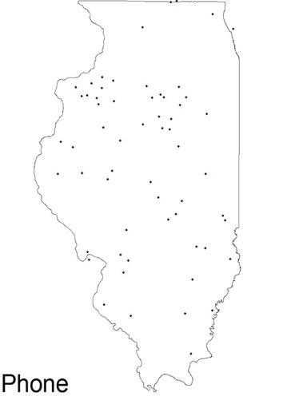
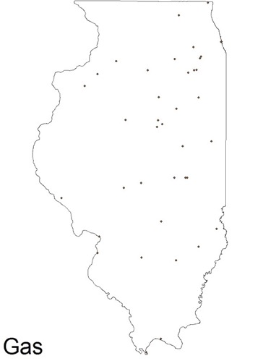
Illinois Utility Comparison
Vs.

Slide 10
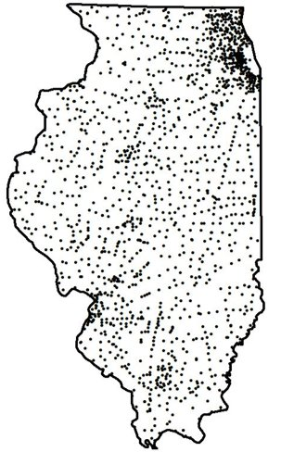
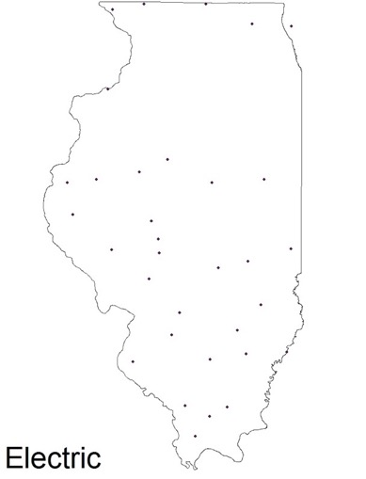
Illinois Utility Comparison
Vs.
Water

Slide 11
America’s Water Infrastructure
“If someone was designing a system of water utilities today, no responsible person or committee seeking efficiency, cost controls, and high-quality drinking water would conclude that having thousands of them – let alone tens of thousands – make any sense” – Troubled Water by: Seth M. Siegel

