Slide 1
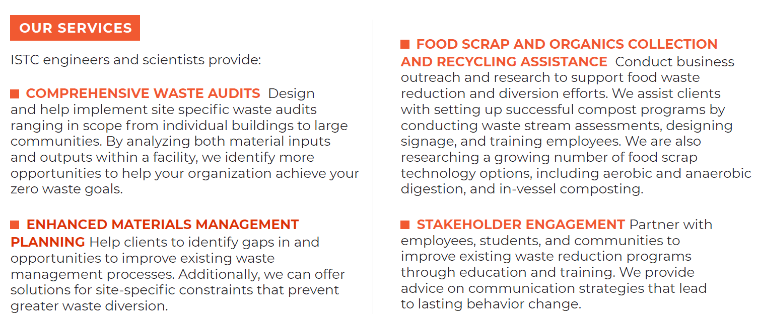
Zero Waste tap.istc.illinois.edu/programs/zero-waste

