Slide 1
IEPA – SRF FUNDING City of Macon
A Brief History
Notes:
This will be a brief presentation covering the City of Macon’s journey to receive funding through the Illinois Environmental Protection Agency’s revolving loan fund.

Slide 2
Original Project
Replace Meters
Replace Automated Meter Reading Technology
Notes:
The original project was to replace all of the city’s water meters and automated meter reading technology.

Slide 3
Original Project
Estimated Cost - $360,000
Funds on Hand - $100,000
Shortfall - $260,000
Notes:
The city received an estimate of $360,000 to replace all meters with an automated meter reading system. Since Macon only had $100,000 on hand for meter replacement it was decided to research loan & grant options. The city looked at USDA-RD, IEPA-SRF & low interest loan from NRWA. The City Council decided to pursue a loan through IEPA-SRF as they had the best rates at the time.

Slide 4
Game Changer #1
IEPA Began Offering Principal Forgiveness
City Hit the Pause Button
Held Study Session to Identify Upcoming Needs
Notes:
When Macon was informed that they would qualify for principal forgiveness – 50% of eligible project costs or $500,000 which ever is less. After receiving this information, the City Council elected to pause the original project and study near future needs for the City’s drinking water system.

Slide 5
Updated Project
Replace Meters and Meter Reading System
Replace Approximately 2.5 Miles of 60-year-old Well Line
Replace Control Structure at Well Field
Notes:
The City Council’s Water Committee met with personnel and identified the following infrastructure that needed to be updated or replaced.
Replace the water meters and meter reading system that had reached the end of its life cycle
Replace a 2.5 miles of 60-year-old cast iron water main that was experiencing multiple breaks per year with an eight-inch PVC main
Replace the control structure at the well field with a new modular building that would include the up-sized piping and new controls

Slide 6
Updated Project
Replace One Block of Undersized Distribution Main
Replace Two Aged Aerators with One Larger Aerator
Install New Backup Generator at Well Field
Notes:
4. Replace one block of undersized distribution system watermain to meet current IEPA regulations
5. Replace two aged painted steel aerators with one larger aluminum aerator to reduce future maintenance costs
6. Install a new stationary backup power source at the well field for use when there is a power outage.

Slide 7
Updated Project Costs
Engineer’s Estimate –Approximately $1,800,000
IRWA Completed a Rate Study
Determined Project was Affordable
Notes:
1. With the updated project list the cost was estimated to be $1.8 million. Macon contacted IRWA to complete a comprehensive rate study to determine whether the project costs were affordable and what changes would need to be made to current rates. It was determined that, with some financial assistance from the City’s TIF fund, the project costs were reasonable.

Slide 8
Updated Project
Engineers Were Retained
Easements Were Sought
PANDEMIC
Went Out For Bid
Bids Were Opened
Notes:
Macon’s engineers were instructed to complete project drawings, bid specs and IEPA-SRF application. They were also tasked with obtaining all needed easements for the well line. In the middle of all this, the pandemic hit. As we are all painfully aware, the pandemic was another game changer in that costs skyrocketed!
Macon advertised for bids, and they were opened around the first week of June 2022.

Slide 9
Game Changer #2 The Pandemic!
Bid Opening Revealed a Low Bid of $2,800,000
Project Cuts Considered
Game Changer #3
Notes:
Macon was in for a shock when bids were finally opened, and they came it at $2.8 million - $1,000,000 above original pre-pandemic estimates
The City Council considered cuts to the project but felt that if items were cut, the likelihood of them being completed in the near future were pretty slim.
Then Game Changer #3 was presented at the last minute.

Slide 10
Game Changer #3
IEPA Set New Rules for SRF Loan Program
Principal Forgiveness was Now 50% of eligible Project Costs or $1,000,000 – Whichever is Less
Renewed Rate Study
Project is Currently Under Construction with No Cuts
Notes:
Game Changer #3 came from the IEPA by way of an announcement that the rules for principal forgiveness had changed for the new state fiscal year – beginning July 1, 2023.
Since Macon had already opened bids, they thought the old rules would apply to their loan. The Mayor was informed that Macon would qualify for the new terms as long as contract documents had not been executed. They had not so Macon received the more favorable terms. In this case – timing is EVERYTHING!
With the updated terms, Macon requested IRWA update the recently completed rate study to determine if the full project could move forward. . IRWA was able to show that with the updated principal forgiveness and with some additional input from the City’s TIF fund, the project was still viable.
No cuts were made to the project and contracts were awarded. Construction is underway at this time.

Slide 11
Things Gone Wrong
So, what happens when things go wrong with a loan?

Slide 12
Things Gone Wrong
Brief Case Study of a Loan That Went Awry

Slide 13
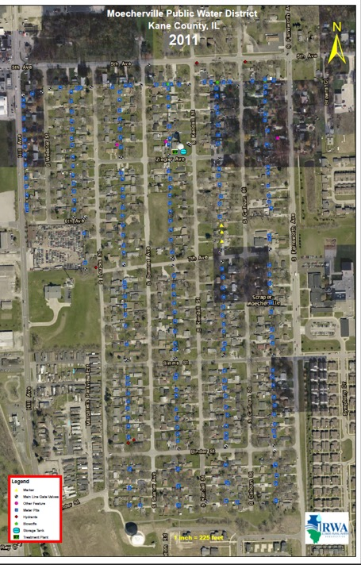
Moecherville Water District, NFP
Receivership
2010
Notes:
In 2010, a Not-For-Profit water system, Moecherville, NFP, attempted to file bankruptcy on a loan to the United States Department of Agriculture’s Rural Development Program
They were unsuccessful in their attempt to file for bankruptcy and were placed into receivership.
Receivership - Receivership is a form of debt restructuring that helps an entity in dispute avoid bankruptcy or liquidation while lawsuits are in progress. In this case USDA-RD had filed foreclosure actions on the system.

Slide 14
Things Gone Wrong
IRWA Contacted
IRWA Appointed Receiver
IRWA Assumed Control October 2010
Notes:
IRWA was contacted by representatives of USDA Office of Investigation and the United States Attorney General’s Office to see if the Association would consider becoming Receiver for the financially struggling MWD.
In October of 2010, IRWA agreed and took control of the assets of MWD after the struggling system was served with the Receivership Order by a Deputy from the United States Marshall’s Office.

Slide 15
Things Gone Wrong
MWD Had Received Approximately $5,000,000 in Loans & Grants
5 Years – No Payments
Why?
Notes:
MWD had received approximately $5,000,000 in loans and grants to build out an entirely new water system. This included 2 new wells, water tower, water treatment plant, distribution system, automated meter reading system, office equipment, and software. MWD had approximately 450 metered customers and was about 95% Spanish speaking population.
In five years MWD had not made any payments on their loan to the USDA-RD. WHY?

Slide 16
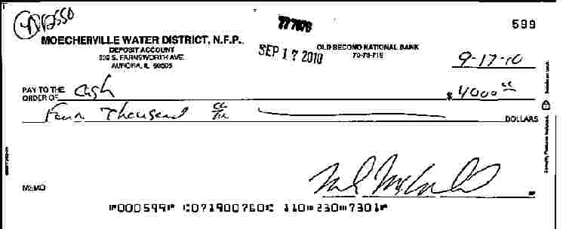
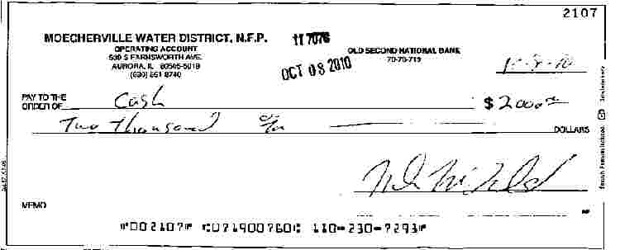
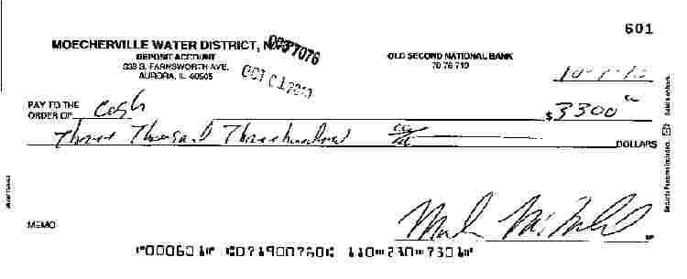
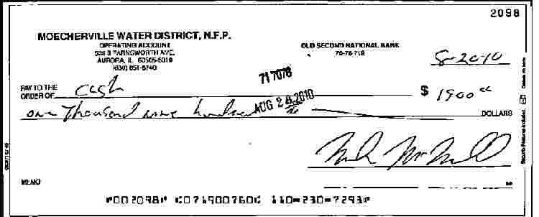
Things Gone Wrong
Notes:
One reason was discovered within an hour of IRWA assuming receivership. During a quick review of MWD’s bank statements there was a number of suspicious transactions noted. Several checks were made out to CASH and then cashed by the MWD Board President. No supporting documentation was found to explain these transactions.
Originally the Board President stated he had no knowledge of these checks and did not cash them.

Slide 17
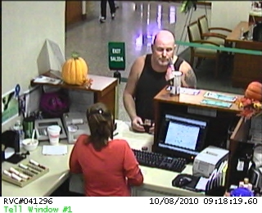
Things Gone Wrong
NOT SO!
Notes:
The bank where the checks were cashed records every transaction and there is the Board President cashing the checks. He then stated he cashed the checks to buy supplies for the water system, but he could not produce any receipts.

Slide 18
Things Gone Wrong
Cash Deposits From Payments
Declined Significantly
Records Show Cash Payments
Notes:
Cash deposits from receipts declined significantly over the past 18 months.
Prior to the decline in cash deposits, MWD used to deposit $400 - $500 per week from cash payments. This declined to near zero during the last 18 months.
Oddly enough, receipts for payments would track cash vs check payments. No one could explain the discrepancy.

Slide 19
Things Gone Wrong
Staffing
Board President
Office Manager
Assistant Office Manager
Contract Operator
Full Health, Dental, Vision
Notes:
Employee costs were extremely high for such a small Not-For-Profit water system. Drawing fulltime salaries were the Board President, Office Manager, and an Assistant to the Office Manager. The Office Manager was the Board Presidents live-in girl friend, and her daughter was her assistant. They worked approximately 20 hours per week.
The Board President, Office Manager, and Assistant to the Office Manager were all supplied with full health, dental, and vision insurance through MWD. The contract operator declined coverage when the Board President offered it. In fact, the contract operator was the only person that was not raiding the water system’s treasury and was retained to operate the system during IRWA’s Receivership.

Slide 20
Things Gone Wrong
So, What Happens to a System That is Deemed Insolvent and Foreclosed Upon?

Slide 21
Things Gone Wrong
Notes:
Two years after being placed into Receivership, all assets were sold to the highest bidder on the courthouse steps in Kane County. The sale price was approximately $1.3 million.

Slide 22
Things Gone Wrong
Inquiring Minds Might be Asking – “What Happened to the Board President?”
Notes:
Although the system was sold on the courthouse steps, the Board President was still being investigated.

Slide 23
Things Gone Wrong
Guilty!
Notes:
Two years after MWD assets were sold, the Board President pled guilty to tax evasion and was sentenced to three years.

