Slide 1
Contextual Challenges of Regionalizing Rural Water Infrastructure
Ann-Perry Witmer
Senior Research Scientist
4 November 2022

Slide 2
Challenges of Regionalization
Require collaboration among stakeholders
Require significant administrative support – central authority/arbiter
Dependent upon land use, government structure, rate-making
Not a one-size-fits-all application
Context Matters

Slide 3
How do we Know Context Matters?
By whom??
Project need is identified
Project designers are engaged
Project is designed
Project partners disengage
Project Fails
By whose definition??
From where??
Through what mechanism??
On what basis??

Slide 4
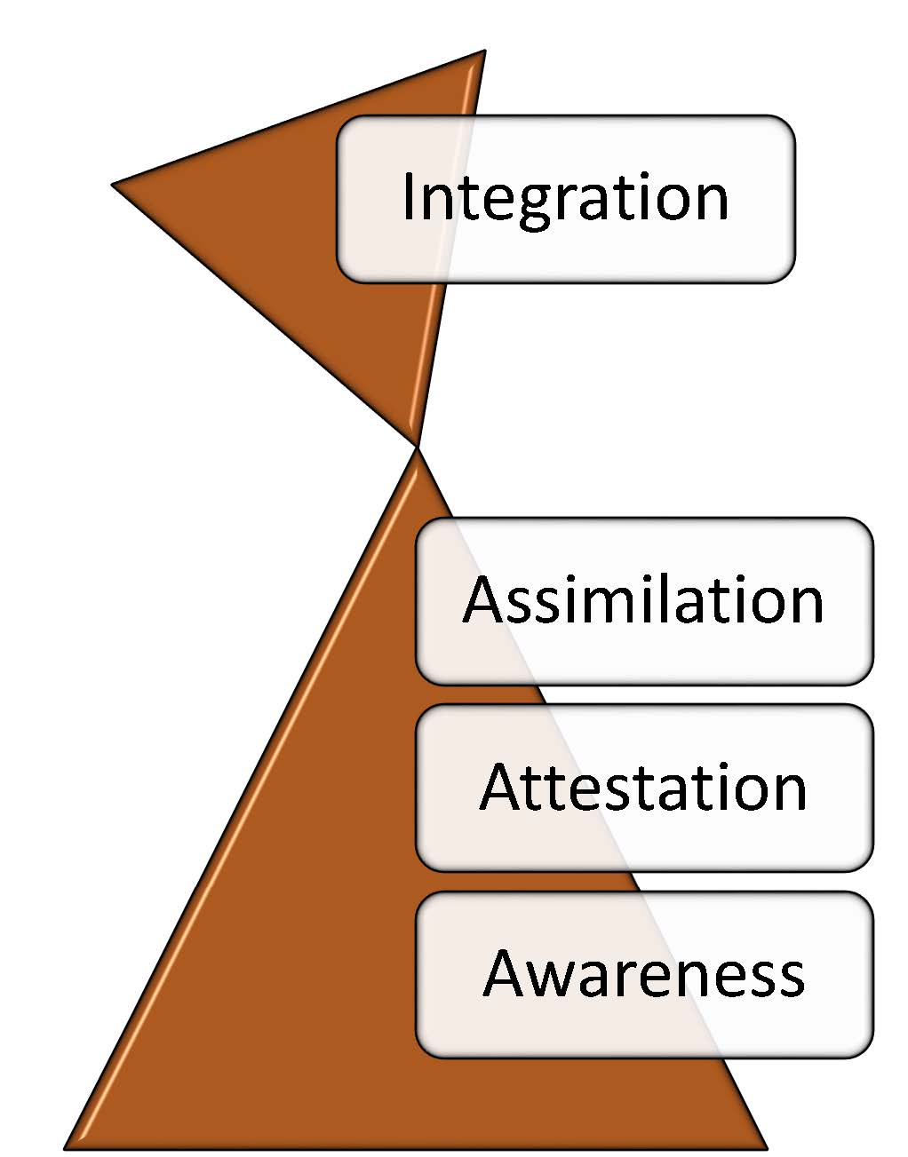
CIP Methodology…as easy as 3-4-5
Three Levels of Perception
Observer Calibration
Four Quadrants of Inquiry
Preliminary Evaluation
Five Critical Influences
Quantitative Evaluation
Political
Mechanical
Cultural
Educational
Economic
Global
Local
Process
People

Slide 5
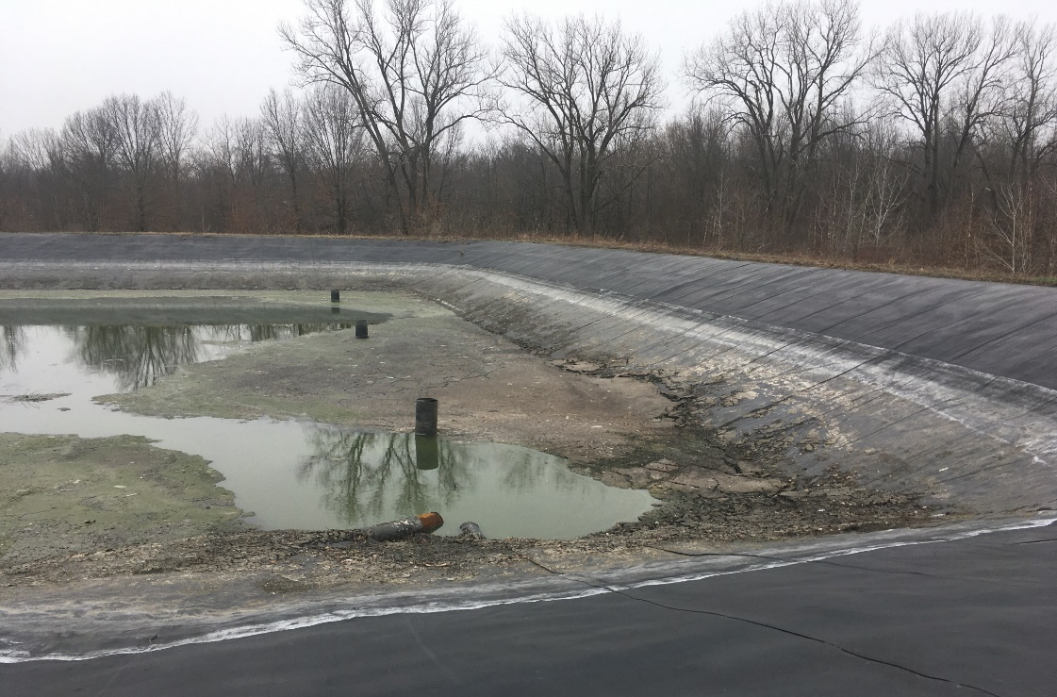
Project Example – Rural Wastewater Treatment Rehabilitation Project
Context
Treatment plant oversized by factor of 10
Many components never used over 30+ yrs
No record of maintenance history
Rate structure does not support infrastructure operation/maintenance
Median income: $18,523 (State of Illinois: $65,040)
99.6% minority
Poor soils in agricultural economy
Municipal income reduced by non-profit land purchases
Historically marginalized by county, state, and federal government
Innovatively self-sufficient in remaining compliant with environmental regulations
Rehabilitation Options
Repair/replace facility equipment as designed
Downsize facility/decommission excess equipment
Rehabilitate facility and regionalize service

Slide 6
Project Example – Rural Wastewater Rehab Project
PROJECT ASSESSMENT USING THE FOUR QUADRANTS OF INQUIRY
GLOBAL
Lit review and site visits
Historical ties to slavery
Ongoing tensions with government (county, state, federal)
LOCAL
Community Survey of Need
Food desert/faith-based community
Situated on rare historical wetlands (“The Everglades of the North”)
Unreliable cellular and broadband service
PROCESS
Design of Services
Assessment of existing service delivery methods by contextual influence dominance
Application of Innovative Self-Sufficiency
PEOPLE
Recorded Interviews with Selected Community Members
Screening analysis of embodied signals (see Mary P.’s work) to better assess African-American populations

Slide 7
Project Example – Rural Wastewater Rehab Project
CONCLUSIONS
Relationship with neighboring communities is fraught
Operators are technically competent
Communities are economically strained
Administration is procedurally challenged
WHAT THIS MEANS
Relationships must be considered
Need clarity of responsibility
Equitably share expenses and operational costs
Define ongoing administration of regionalized system

Slide 8
Thank You
Ann-Perry Witmer, PhD, PE
awitmer@Illinois.edu
217-244-7805

